Slide 1
Wabash Capstone
Project Notes 01
By: John Danison

Slide 2

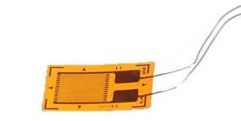
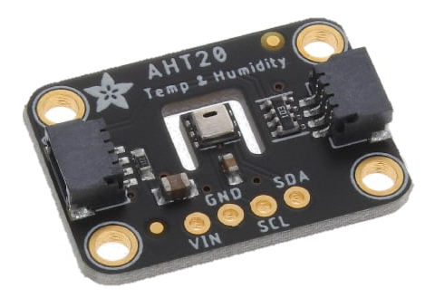
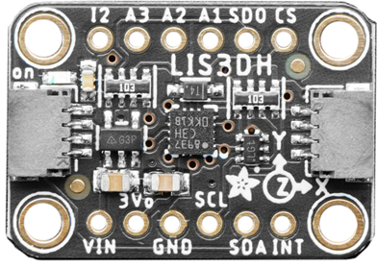
What Have I Done This Week
Met In Person w/ Client
  Reviewed & Gained Insight Into Project
Reviewed What Current State-Of-The-Art Is
  Researched patents, products, & more.
  Wrote 2.2 in CW16
Started Brainstorming System Sensors
Started Brainstorming System Power

Slide 3
Did I Do What I Say I Would Do?
Yes, I feel that I met my promises this past week. There is nothing outstanding where I am holding my group back from making progress.
I have attended every class so far.

Slide 4
Plans For Upcoming Week
Continue To:
Research Existing Solutions & Define SOTA.
Brainstorm Sensors, Power Systems, & Data Acquisition Strategies
Communicate with Team Members
By EOW, Have Finalized Scope Of Work & Timeline

